Slide 1
Voting Web Application using Django Framework
Developed By
Praveena V
NM id: au922221104036
B.E CSE III year
Theni Kammavar Sangam College of Technology

Slide 2
Overview
This is a simple Django-based web application that allows users to vote on various categories. Users can view available categories, vote for their favorite items in each category, and see the voting results in real-time.
The purpose of the web application is to allow users to vote on various topics or items.

Slide 3
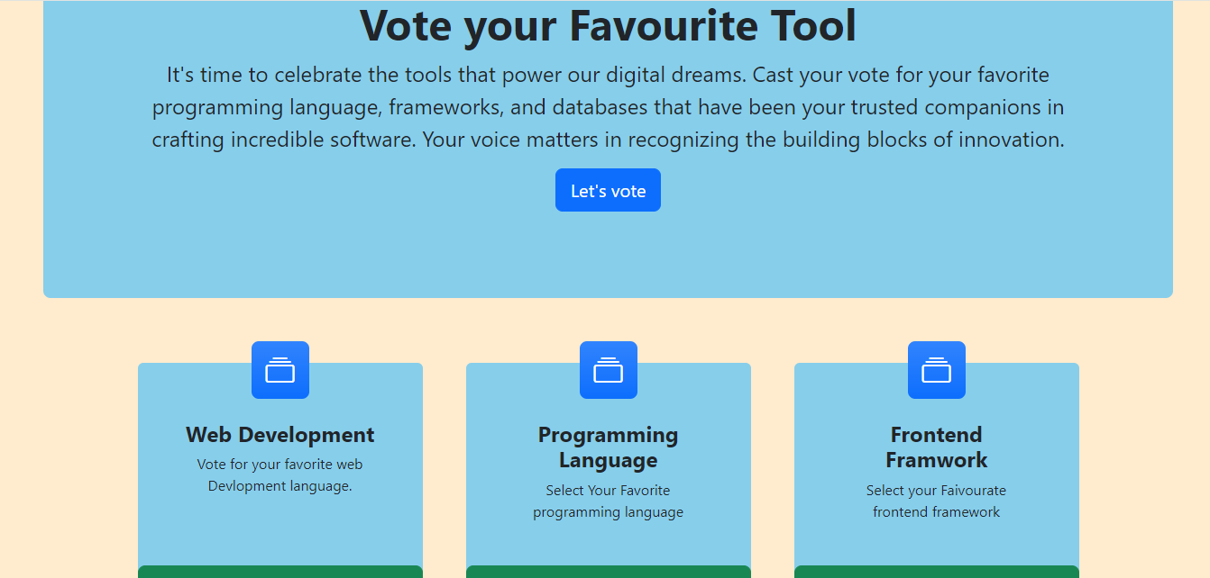
Web Application Image

Slide 4
Features
User-friendly interface for voting on categories.
Real-time updates of voting results.
Secure user authentication and authorization.
SQLite database for data storage.
Responsive design for mobile and desktop.

Slide 5
Prerequisites
Python (3.6 or higher)
Django (3.0 or higher)
MySql

Slide 6
Usage
Browse the available categories on the homepage.
Click on a category to view its items and vote for your favorite.
Check real-time voting results on the results page.
Use the Django admin panel to manage categories and items.

Slide 7
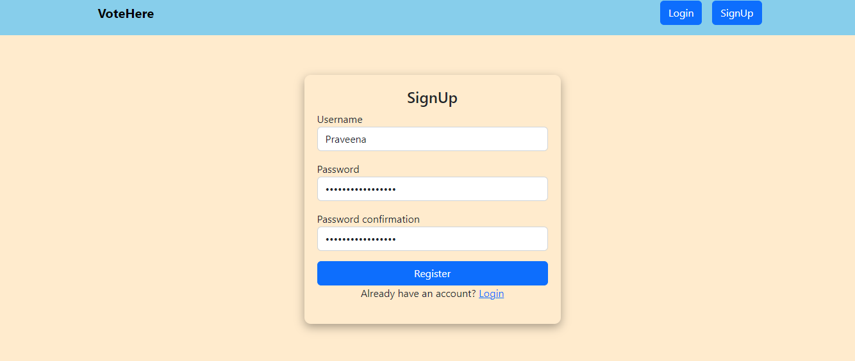
Web Application Process Flow Signup Page Signup Page: New user Create a new Account

Slide 8
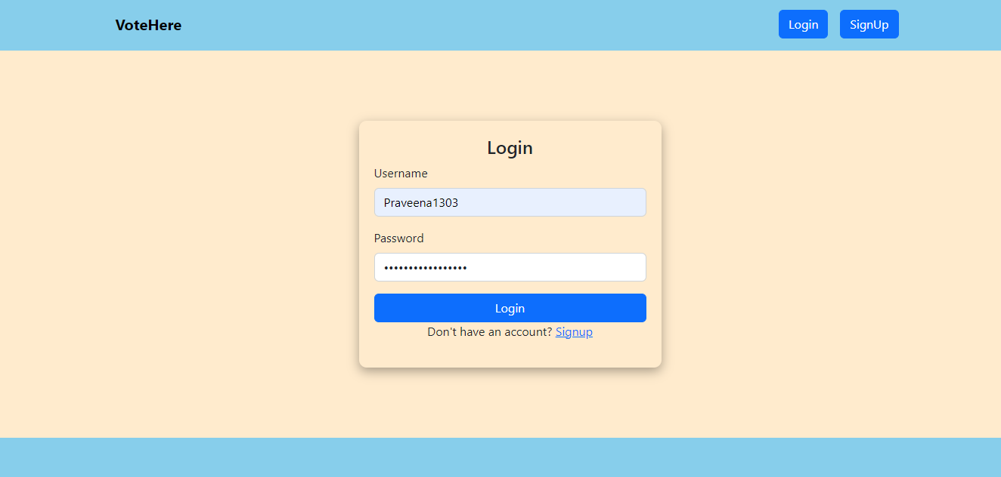
Login Page After Signup ,login using credentials

Slide 9
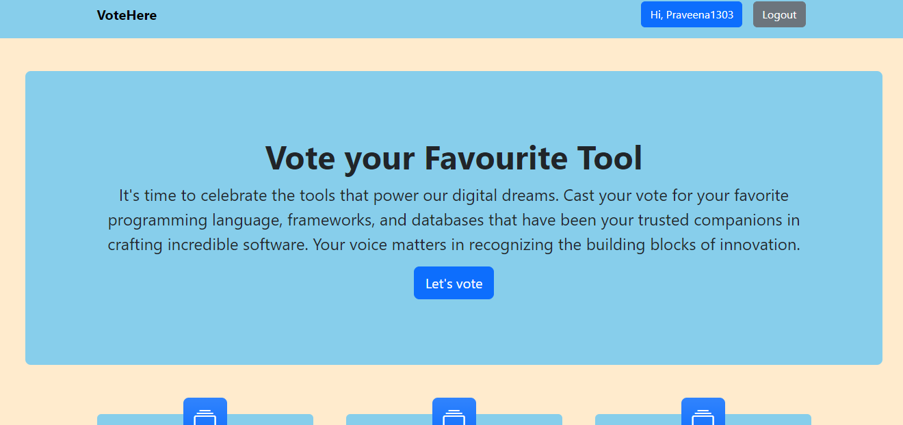
Home Dashboard After login using credentials, voter will see this pages.

Slide 10
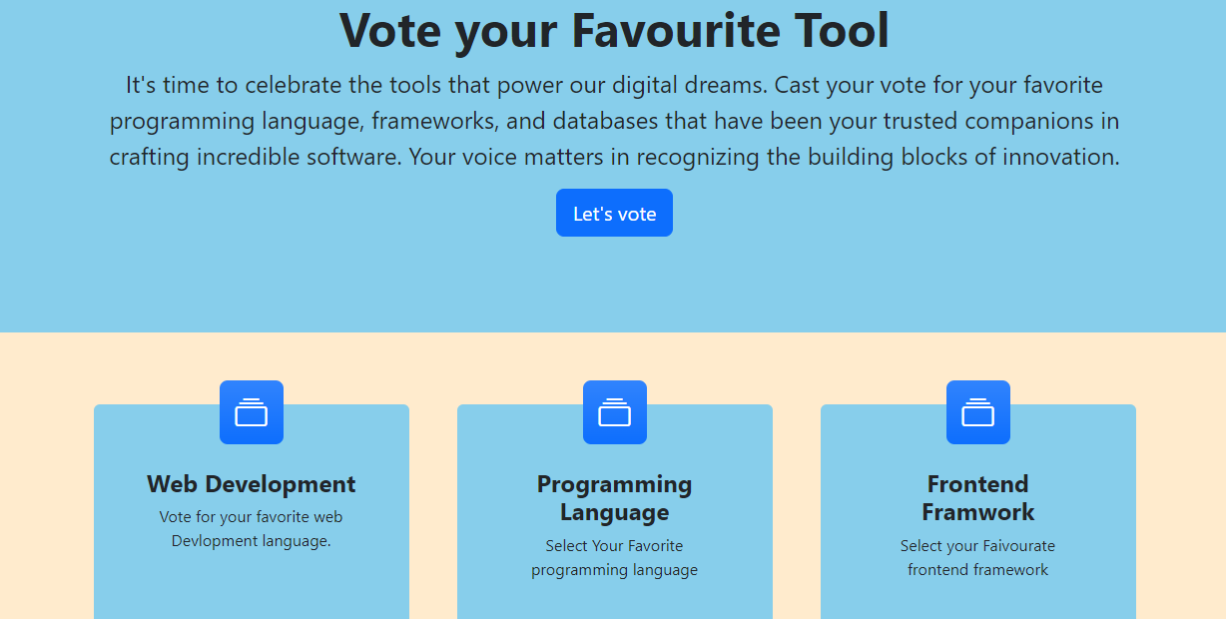
Dashboard after Login Category Page: Browse categories and select one to vote.

Slide 11
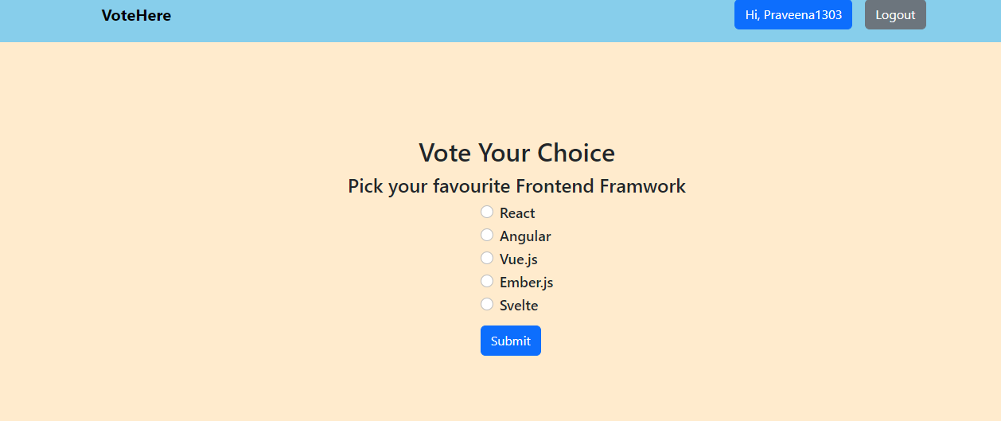
VOTING PAGE Vote Page: Vote for your preferred category.

Slide 12
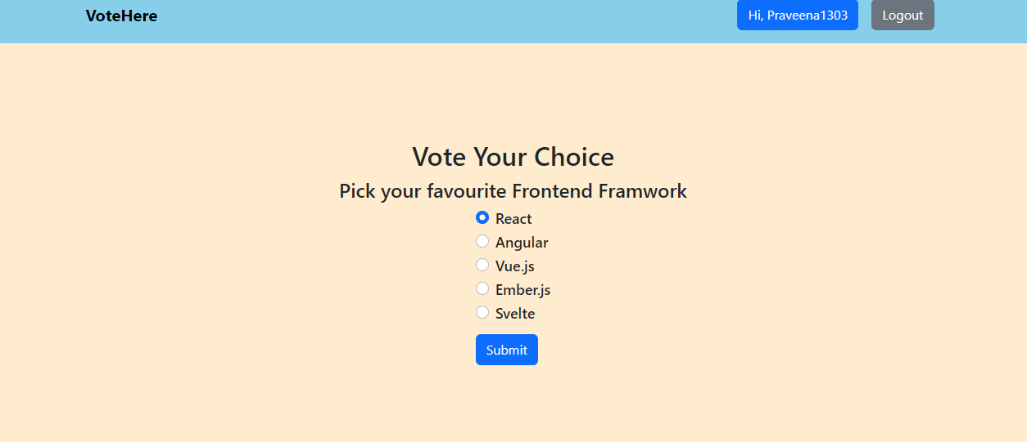
Choose your preferred choice and click submit.

Slide 13
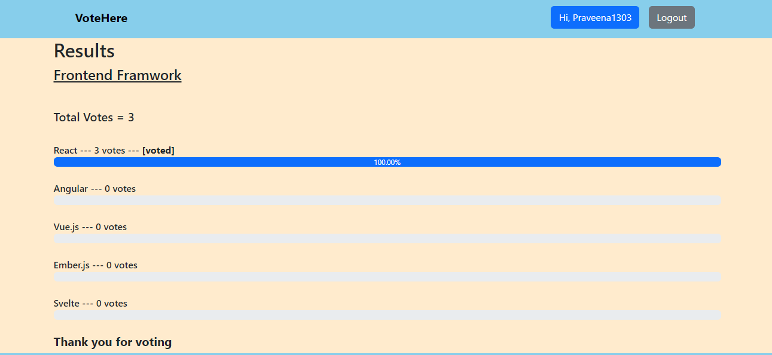
Results Page After clicking submit voters will see results in this page.

Slide 14
THANK YOU

